Slide 1
SIT 725 Prac 1
Basics of Programming and GIT

Slide 2
Contents
Basics of Git
Creating Git Repo
Cloning a Git Repo
Javascript
Creating a Basic javascript application
Live Server Extension
Questions

Slide 3
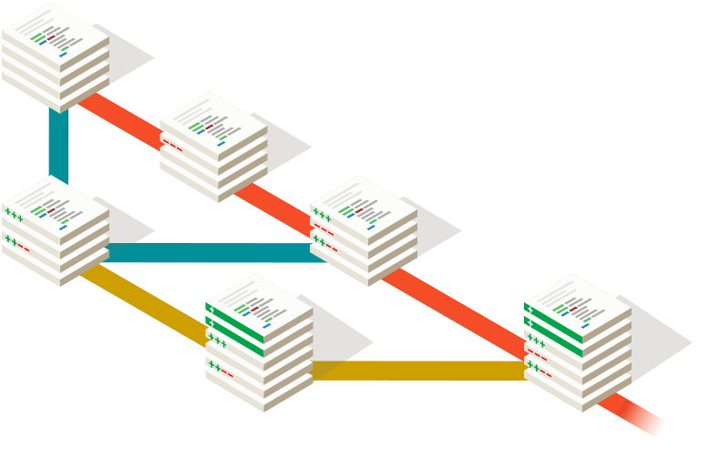
Basics of Git
Git is software for tracking changes in any set of files, usually used for coordinating work among programmers collaboratively developing source code during software development. Its goals include speed, data integrity, and support for distributed, non-linear workflows.

Slide 4
Basics of Git Cont ...
Installation on Mac :
Open Terminal
Install HomeBrew using the command :
/bin/bash -c "$(curl -fsSL https://raw.githubusercontent.com/Homebrew/install/HEAD/install.sh)"
brew install git
Installation on Linux(Ubuntu) :
Open Terminal
sudo apt-get update
sudo apt-get install git-all

Slide 5
Basics of Git Cont ...
Setup Git local configuration
Open the command prompt
Run this command to configure your username and email:
git config --global user.name "Your Username" $ git config --global user.email "youremail@email.com"
In case you want to generate an SSH Key and add to your git you can do so by following the steps here

Slide 6
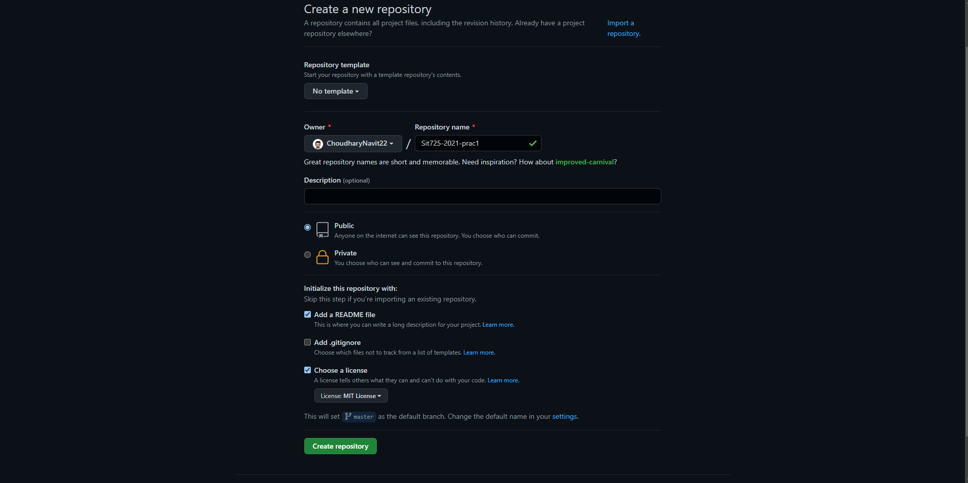
Creating a Git Repo
We need to create a repo online before we start on the system
Navigate to https://github.com/new and create a repo

Slide 7
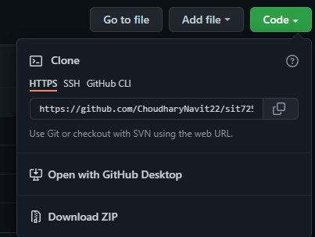
Cloning a Git Repo
In order to clone a git repo, you simply got to the terminal and use the command
Link to your repo is present here
$ git clone <link to repo>
Your password: personal access token
In the upper-right corner of any page, click your profile photo, then click Settings.
In the left sidebar, click Developer settings.
In the left sidebar, you see Personal access tokens
You can also connect using gh:
brew install gh
gh auth login

Slide 8

Javascript
JavaScript is a programming language that was first created in 1994 as a way to add functionality and user interaction to a website. JavaScript is the third of the major building blocks of a web page. Without it, we wouldn’t have the dynamic content and usability we expect from modern websites.
JavaScript was created with the intention of being utilised solely on the front end as a mechanism for web developers to add functionality to their pages, and it did so in its early days. The "V8 engine," introduced by Google recently, has improved the speed and usefulness of JS. As a result, interesting new front end JavaScript frameworks were developed and released, as well as Node.js, a mechanism to run JavaScript on a server.

Slide 10
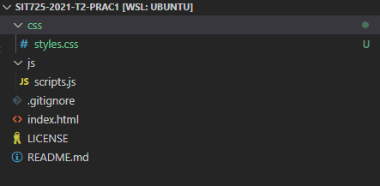
Creating a Basic Javascript application
A simple javascript project has a a few files that help us control our javascript application. These files include:
Index.html: This file holds all the static code that needs to be displayed on the web browser
styles.css: This file is responsible for styling our web page created by index.html
scripts.js: This file is responsible to provide the dynamic changes in our static web page being created by the index.html
The folder structure of a simple javascript file looks something like this.

Slide 11
Creating a Basic Javascript application Cont ...
Now let's add some code to our files. First we start with index.html
<!doctype html>
<html lang="en">
<head>
<meta charset="utf-8">
<meta name="viewport" content="width=device-width, initial-scale=1">
<title>SIT 725 Prac 1</title>
<meta name="description" content="basic template for SIT 725 Prac 1">
<meta name="author" content="SitePoint">
<meta property="og:title" content="SIT 725 Prac 1">
<meta property="og:type" content="website">
<meta property="og:description" content="basic template for SIT 725 Prac 1">
<!-- Compiled and minified CSS -->
<link rel="stylesheet" href="https://cdnjs.cloudflare.com/ajax/libs/materialize/1.0.0/css/materialize.min.css">
</head>
<body>
<div class="container">
<div class="row">
<div class="col s12">
<h1 id="heading" class="center-align">SIT 725</h1>
</div>
<div class="col s12 center-align">
<a class="waves-effect waves-light btn" onclick="changeText()">Change Text</a>
</div>
</div>
</div>
<!-- Compiled and minified JavaScript -->
<script src="https://cdnjs.cloudflare.com/ajax/libs/materialize/1.0.0/js/materialize.min.js"></script>
<script src="js/scripts.js"></script>
</body>
</html>

Slide 12
Creating a Basic Javascript application Cont ...
function changeText(){
var textsArray = ["Text 1","Text 2", "Text 3", "Text 4", "Text 5"]
var number = getRandomNumberBetween(0,textsArray.length - 1)
console.log("Index: ", number)
document.getElementById("heading").innerHTML = textsArray[number];
}
function getRandomNumberBetween(min,max){
return Math.floor(Math.random()*(max-min+1)+min);
}
Next we add some crypting so that we can see some dynamic changes in our web page by adding this code to our scripts.js file

Slide 13
Live Server Extension
Now that we have created our dynamic web page we want to have a look how it looks right, for doing that lets add an extension to our visual studio code that helps us run a live server of our project. You can find the extension here
Once the extension has been installed it will look like something this on your visual studio code .
You can simply press go live and it would open the browser with your current project running. Give it a try!

Slide 14

Thanks

